Slide 1

Back End Engineering
Eco-Conscious
Submitted by: Jashanjit Kaur (2210990440)
Jasjeet Kaur (2210990442)
Kamaljeet Kaur (2210990470)
Kanchan Yadav (2210990471)
Kashika (2210990493)
Submitted to:
Mr. Shiv Mohan
Chitkara University Institute of Engineering and Technology,
Chitkara University, Punjab

Slide 2
Table of Contents
Introduction
Database Design
Technical Details
Key Features
Project Highlights
Conclusion
References/Links used
Q&A

Slide 3


Introduction
Our project idea is to create an eco-friendly e-commerce platform that promotes sustainable products.
The platform not only allows users to shop for eco-friendly items but also suggests alternative products based on specific environmental criteria, helping consumers make more informed, sustainable choices.

Slide 4
Database Design
Product Collection: _id, name, description, price, category, image, instock, productType.
User Profile, Wishlist, Cart, Orders: All the things for specific user by their userID.
Environment Criteria: carbonFootprint, materialSourcing, recyclability, etc.
EcoScore: It is being calculated by considering weightage of each environment criteria.

Slide 5
Technical Details
1. Node.js: JavaScript runtime used on the server to execute backend logic and interact with the database.
2. MongoDB: NoSQL database used to store product data, user information.
3. Express.js: Backend web application framework that handles API routing, middleware, manages authentication using JWT, and facilitates smooth CRUD operations for products, users, Wishlist and orders.
4. React.js: Frontend library for building one page website.

Slide 6
Key Features
1. Sign up, Login, Logout (JWT) : secure and seamless access with JWT-based authentication for a personalized shopping experience.
2. Eco-Score: Each product’s eco-score highlights its environment impact, helping users shop responsibly.
3. Categories & Search: Effortlessly browse or search for products across eco-friendly categories to find exactly wat you need.
4. Filtering by environment Criteria: Filter products by various factors like carbon footprints, recyclability etc.
5. Sorting by price: Easily sort products by price within each category to find the eco-friendly options that fit your budget.

Slide 7
Key Features
6. Product Profile: Detailed product page showcasing sustainability data, including eco-score and environment metrices.
7. Alternative Products: Discover greener alternative with better eco-scores, making sustainable shopping easier than ever.
8. Wishlist & Cart: Add your favorite items in the Wishlist or move them directly in your cart.
9. Buy now and Order history: Buy products, and track your previous orders.
10. User Profile, Edit details, Delete profile: Easily update your profile details or delete your account if needed.

Slide 8
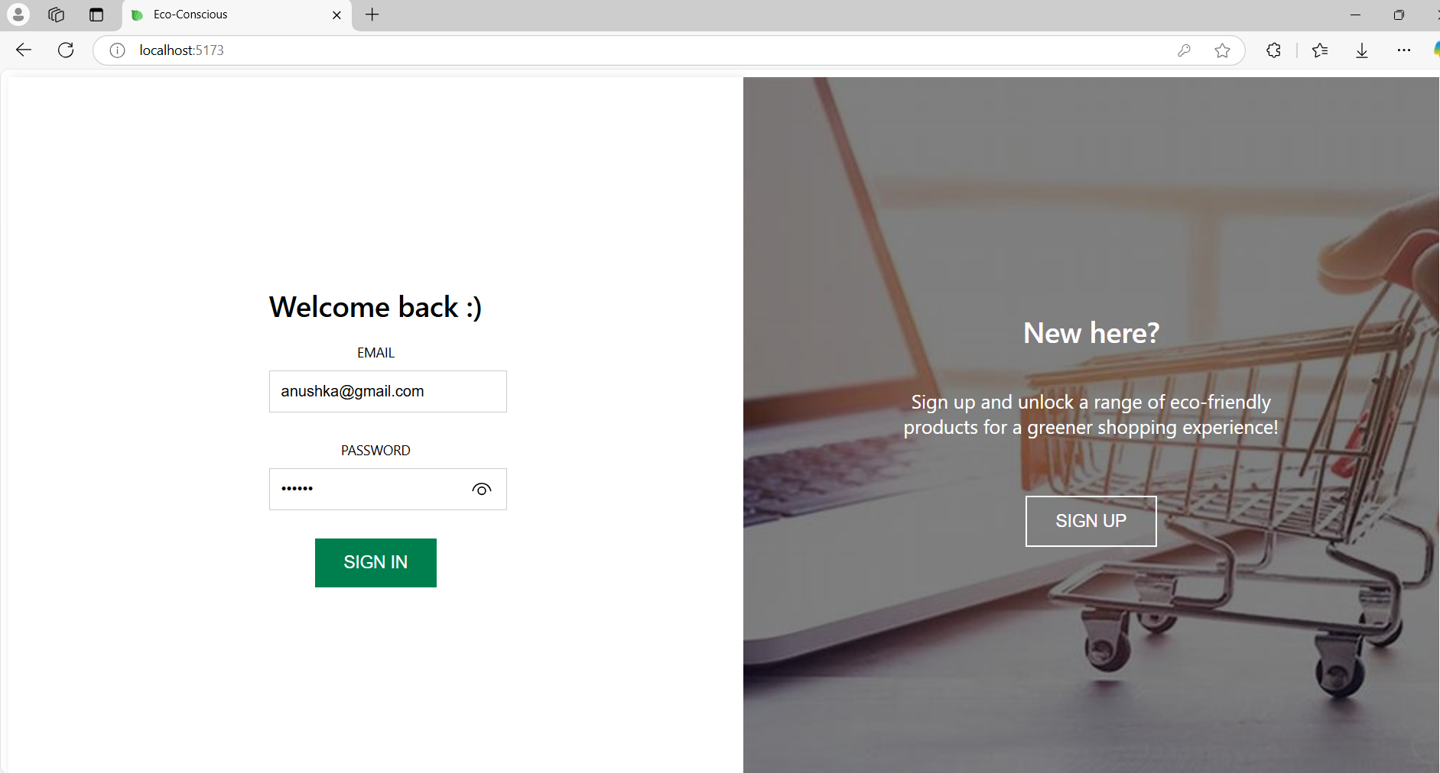
Project Highlights
Signup & Login

Slide 9
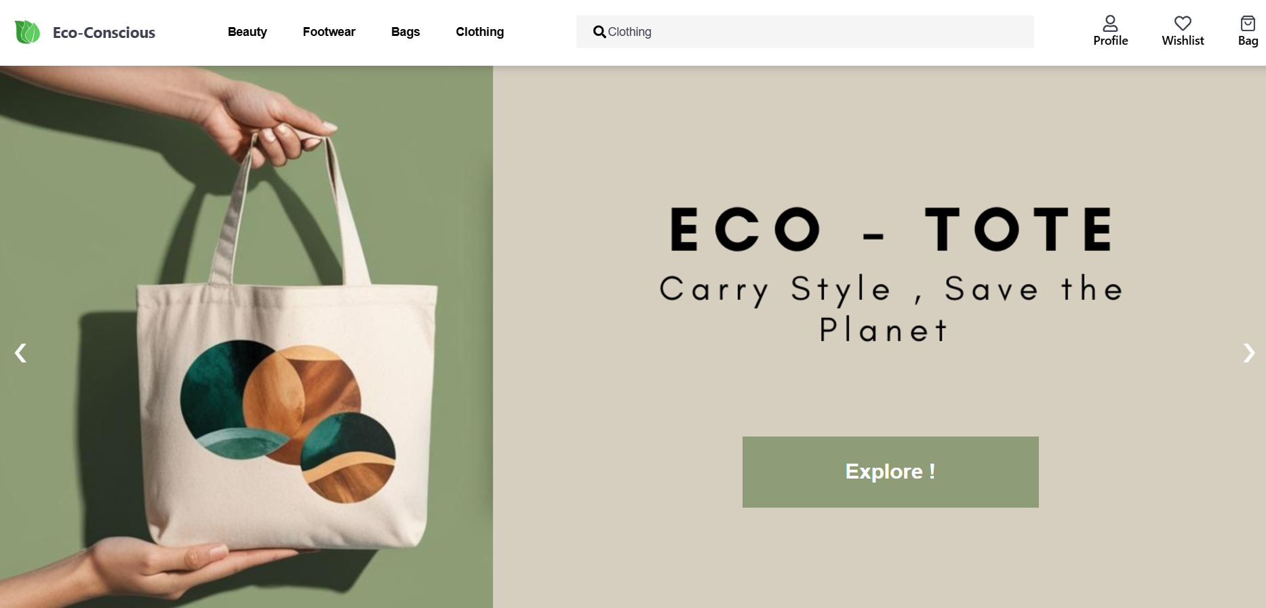
Project Highlights
Home

Slide 10
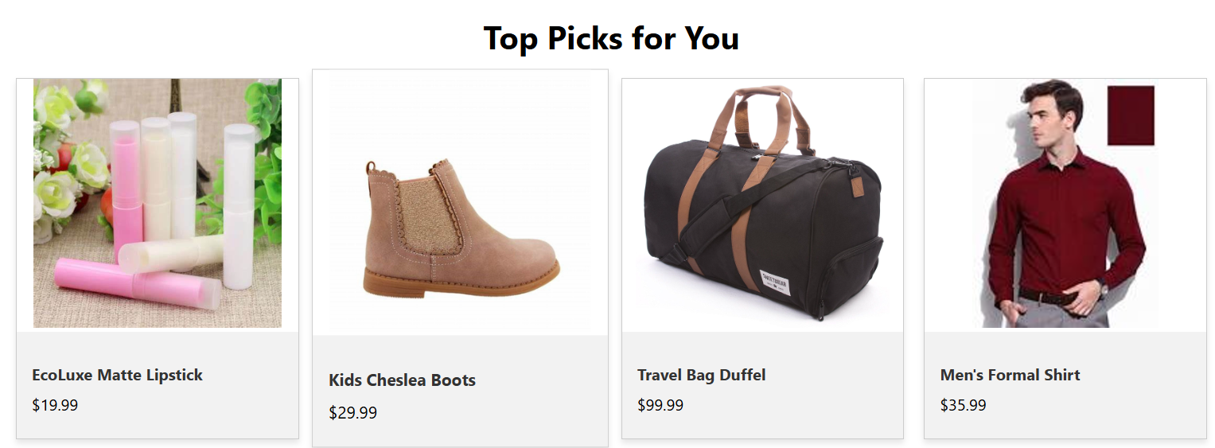
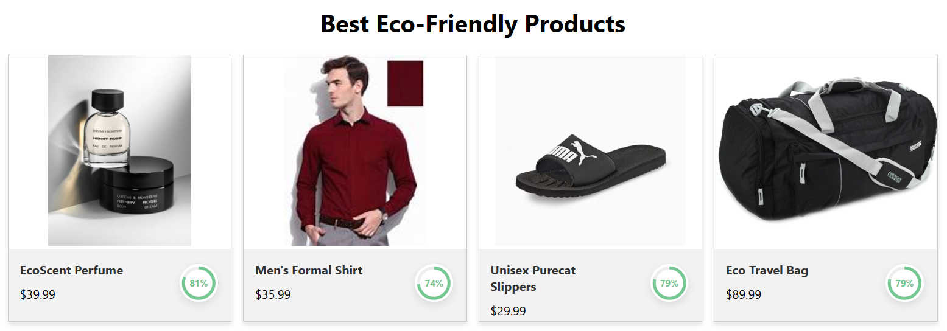
Project Highlights

Slide 11
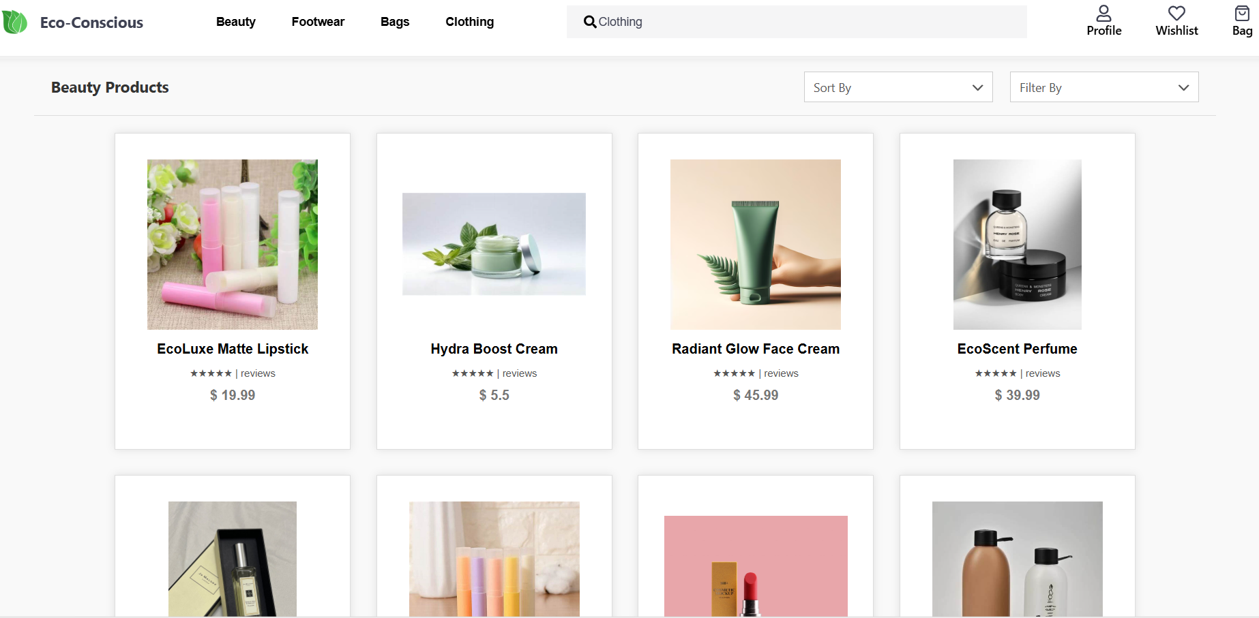
Project Highlights
Category

Slide 12
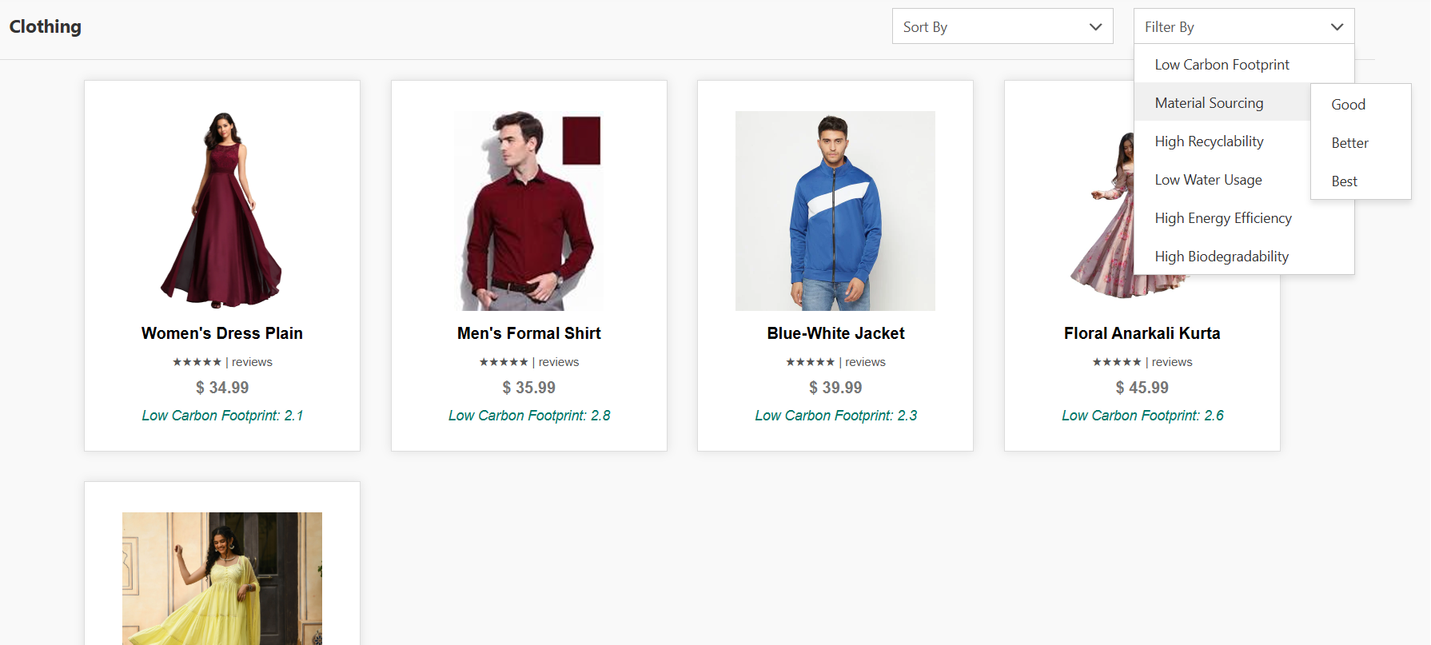
Project Highlights
Filters

Slide 13
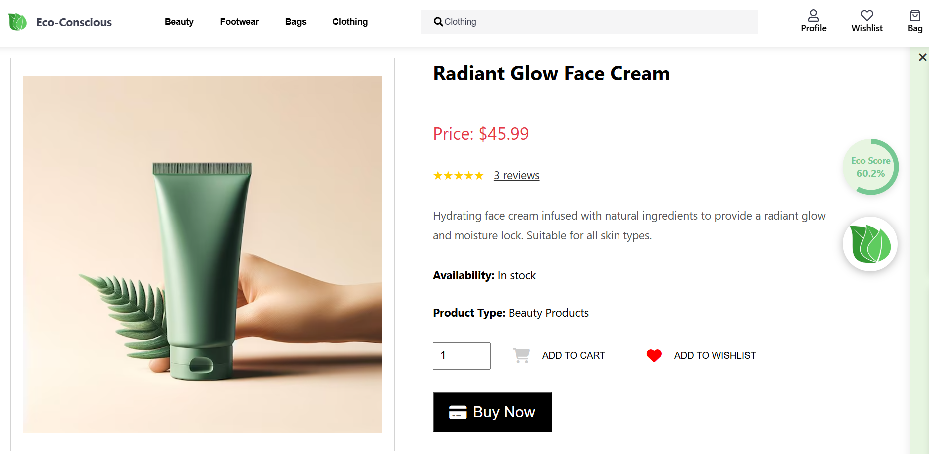
Project Highlights
Product Profile

Slide 14
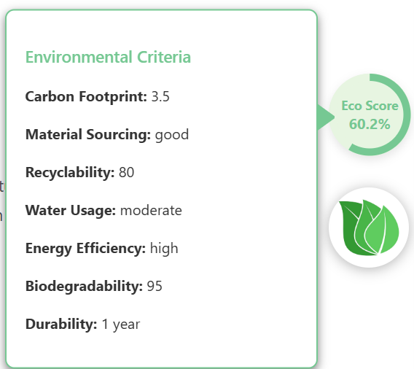

Project Highlights
Environmental Impact

Slide 15
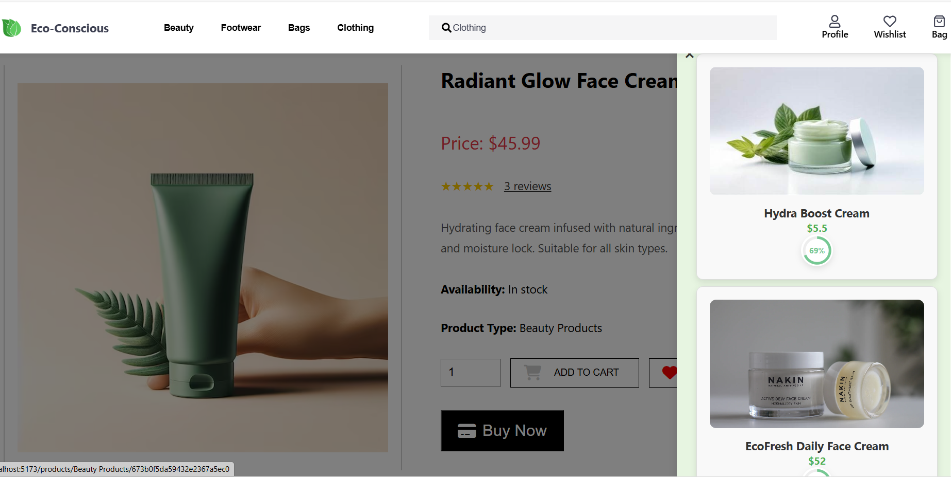
Project Highlights
Alternatives

Slide 16
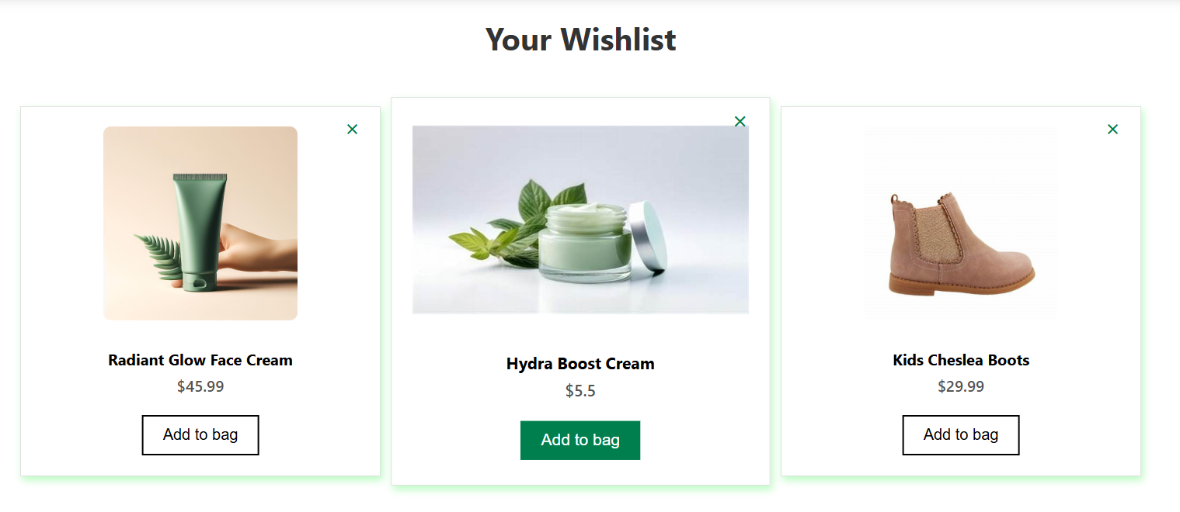
Project Highlights
Wishlist

Slide 17
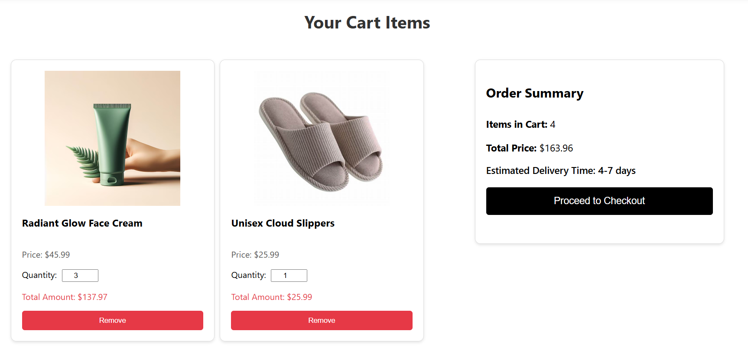
Project Highlights
Cart

Slide 18
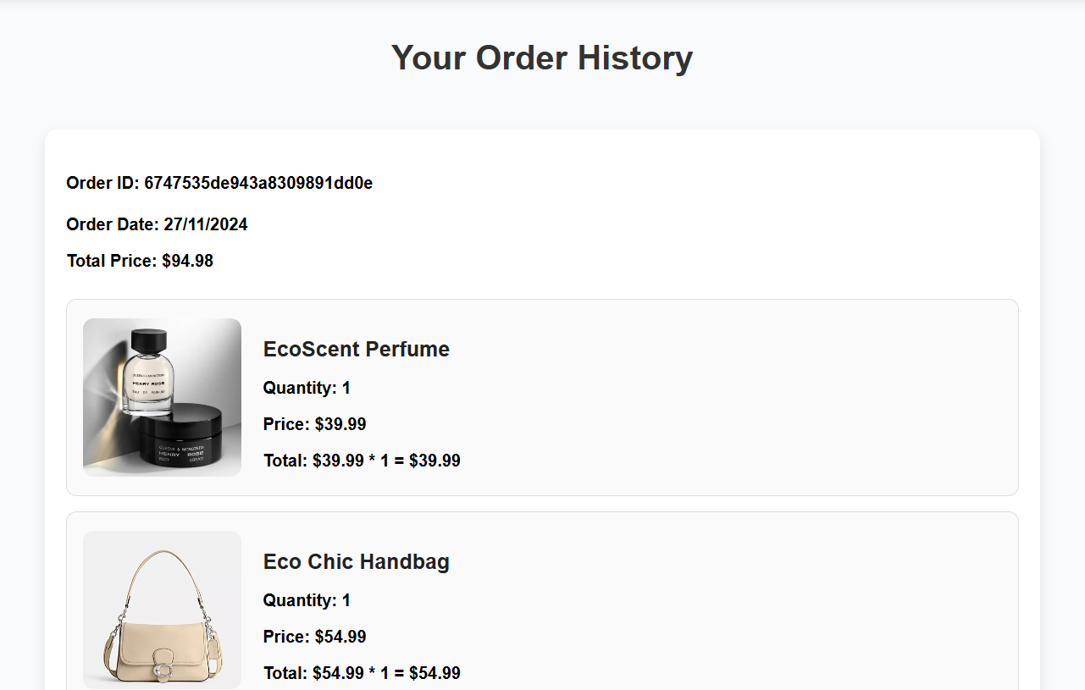
Project Highlights
Orders

Slide 19
Conclusion
Our eco-friendly e-commerce platform is designed to empower consumers to make sustainable shopping choices effortlessly. By integrating advanced features like product eco-scoring, environmental filters, and alternative suggestions, we aim to bridge the gap between conscious consumerism and convenience.
The project leverages modern technologies such as MongoDB, Express, React, and Node.js to create a robust, user-friendly experience that promotes sustainability at every step. As we continue to enhance the platform, our mission remains clear:
“Redefining shopping with purpose for a sustainable tomorrow ☺ ”

Slide 20
Repository Link
https://github.com/ydv-kanchan/Eco-Conscious
Contributing We welcome contributions from everyone! If you're interested in contributing:
Fork the repo
Create a new branch
Commit your changes
Push and create a pull request

Slide 21
References/Links used
https://expressjs.com/
https://nodejs.org/en
https://www.mongodb.com/
https://react.dev/

Slide 22


Slide 23


